Slide 1
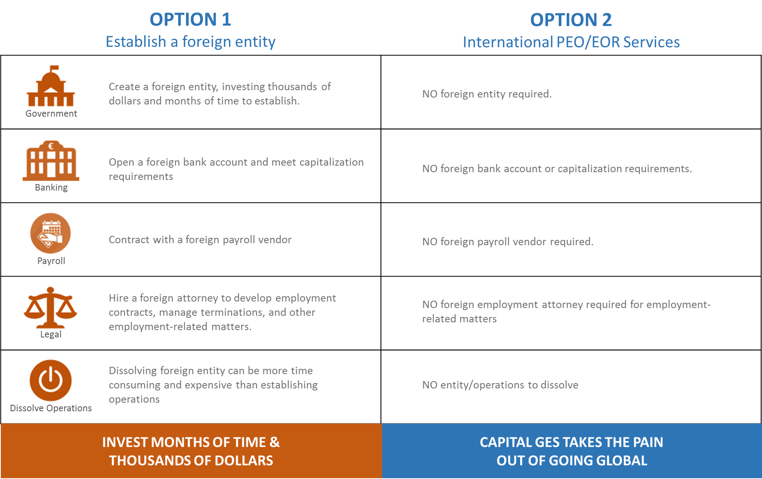
Establishing and Entity vs. International PEO / EOR
5

Slide 2
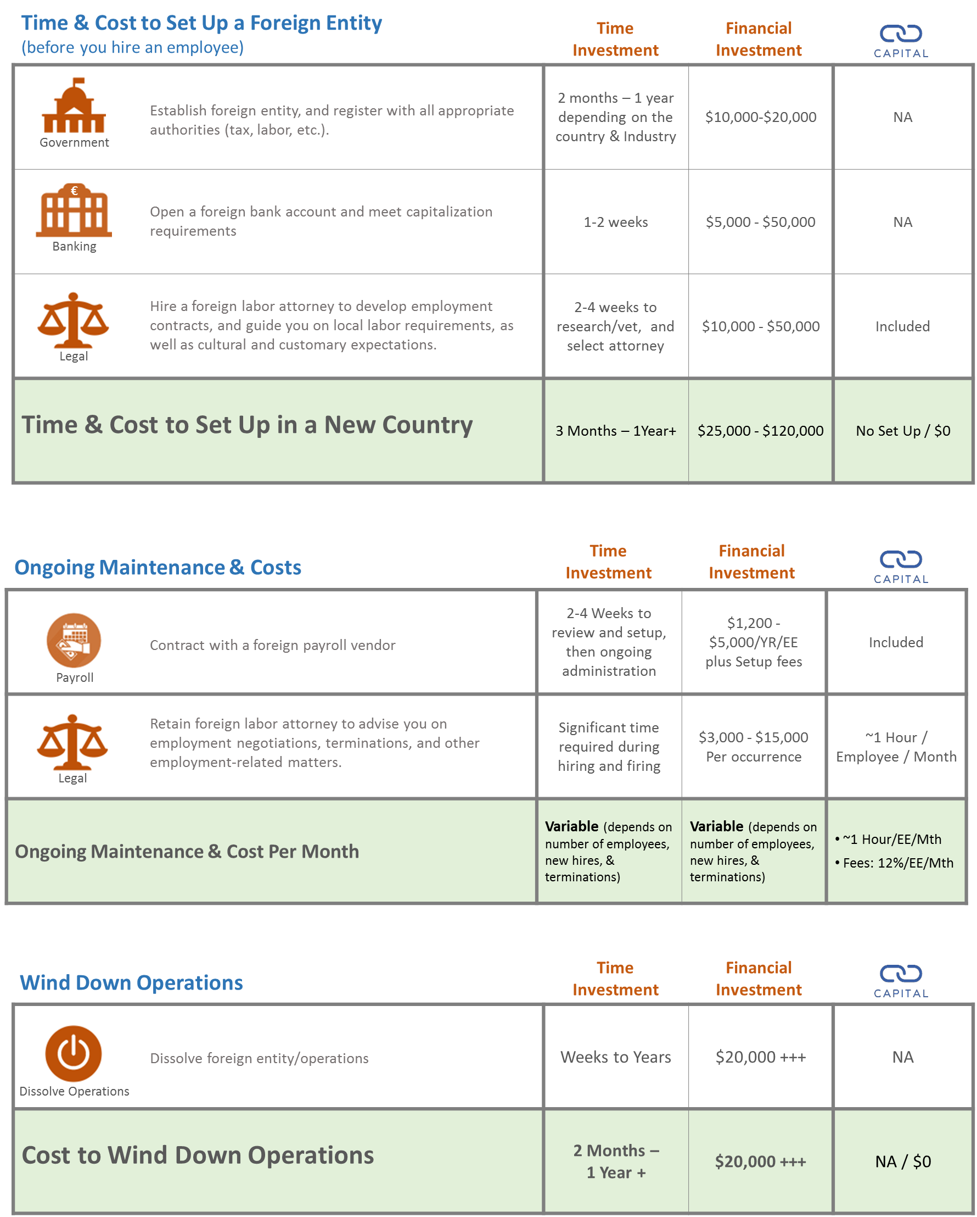
Establishing and Entity vs. International PEO / EOR
6

